Slide 1
Team V1V1 Main_Presentation #8
Image Clasification Challenge
김다현(Kim Dahyun),
박준우(Park Junwoo), 김건호(Kim Geonho)

Slide 2
Contribution
Kim Dahyun: Ensembling with other models, wide_resnet hard voting train,test code, accuracy code
Park Junwoo: Comparing Loss Functions, Data Augmentation, Activation Function, Epochs, Doubled Data and Validation
Kim Geonho : Comparing Optimizers, adjusting the widen_factor, learning rate scheduler, and dropout, as well as applying CutMix
Kim Dahyun : 33%
Park Junwoo : 33%
Kim Geonho : 33%

Slide 3
01
model

Slide 4
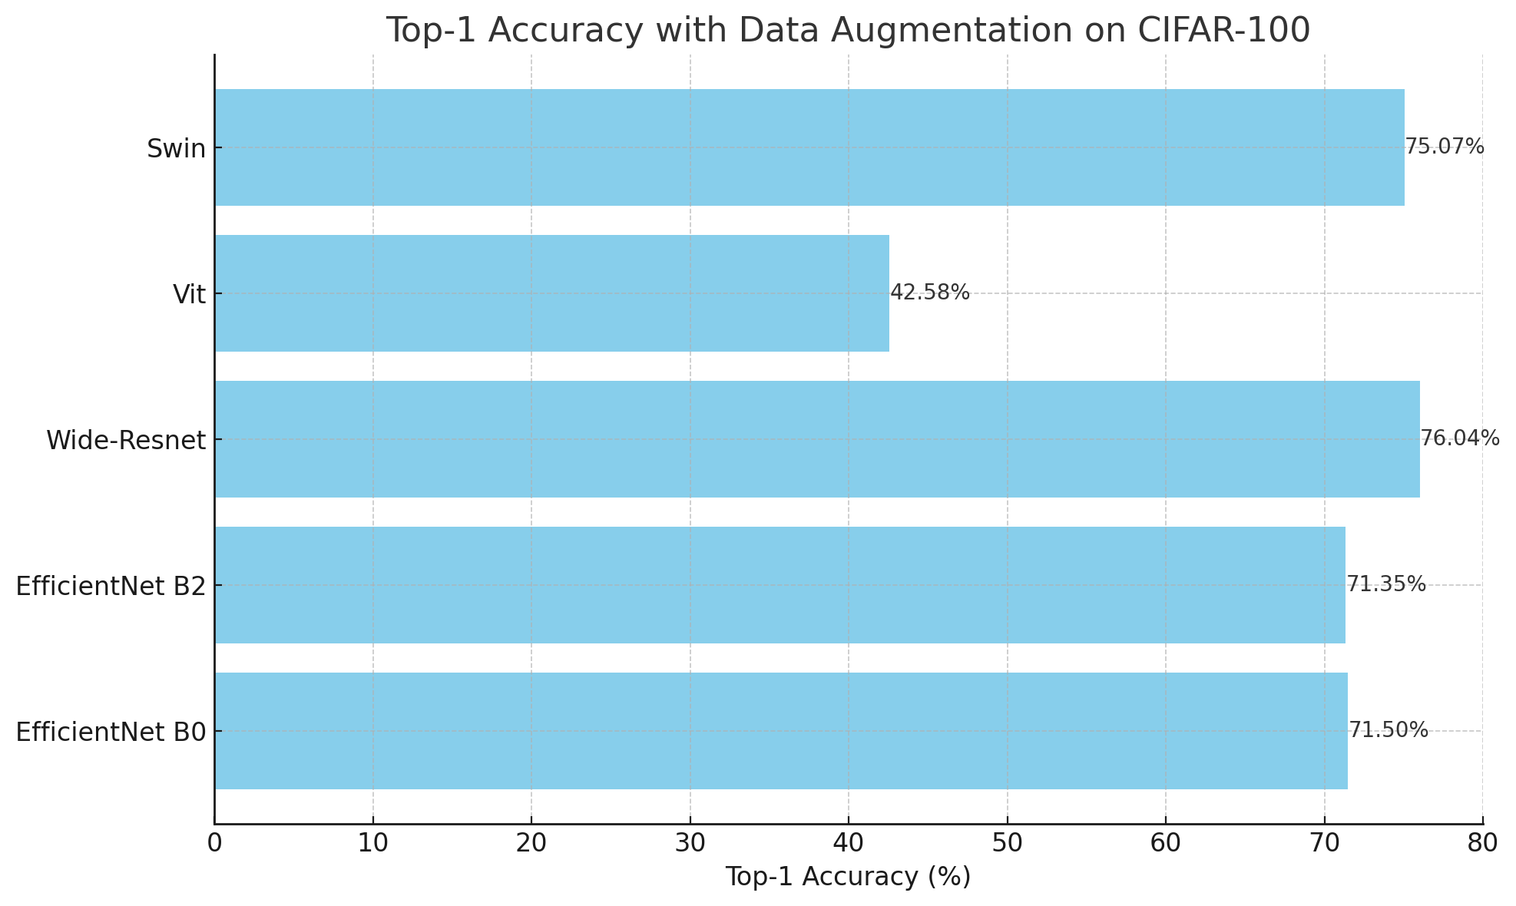
Results
Applied the conditions uniformly
Epochs: 100
Data Augmentation: RandomHorizontalFlip and RandomCrop

Slide 5
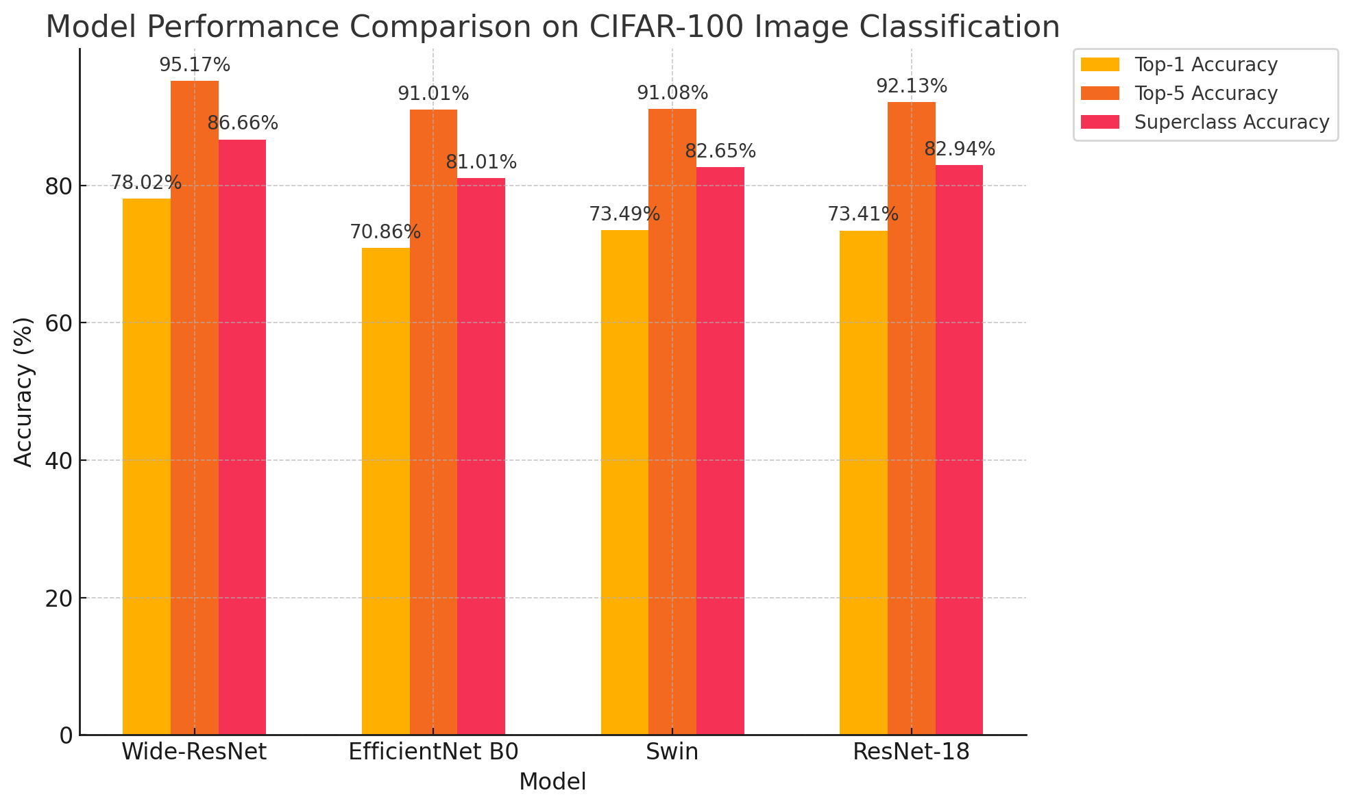
Results
Applied the conditions uniformly
Epochs: 100
Rank
1. Wide-ResNet
2. ResNet-18
3. Swin
4. EfficientNet B0
259.85
242.88
247.22
248.48

Slide 6
02
WideResNet Adjustment Process

Slide 7
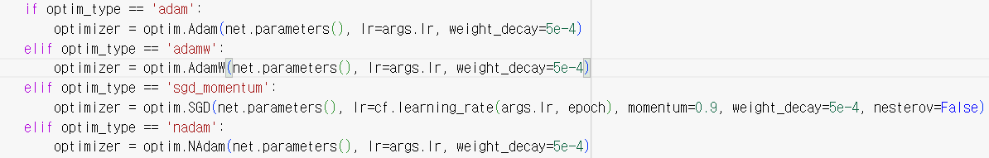
optimizer
In this project, we compared different optimizers, including Adam, AdamW, SGD with momentum, and NAdam. Each optimizer has been applied with specific parameters, such as a learning rate and weight decay, to evaluate their impact on model performance.

Slide 8
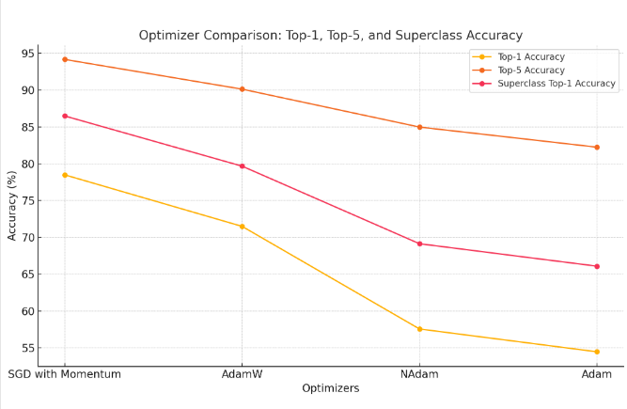
Experiment Results
Based on the results, SGD with Momentum consistently outperforms the other optimizers in all metrics, achieving the highest Top-1, Top-5, and Superclass Top-1 accuracies. Therefore, we have decided to proceed with SGD with Momentum as our optimization method due to its superior performance and reliability in our experiments.

Slide 9
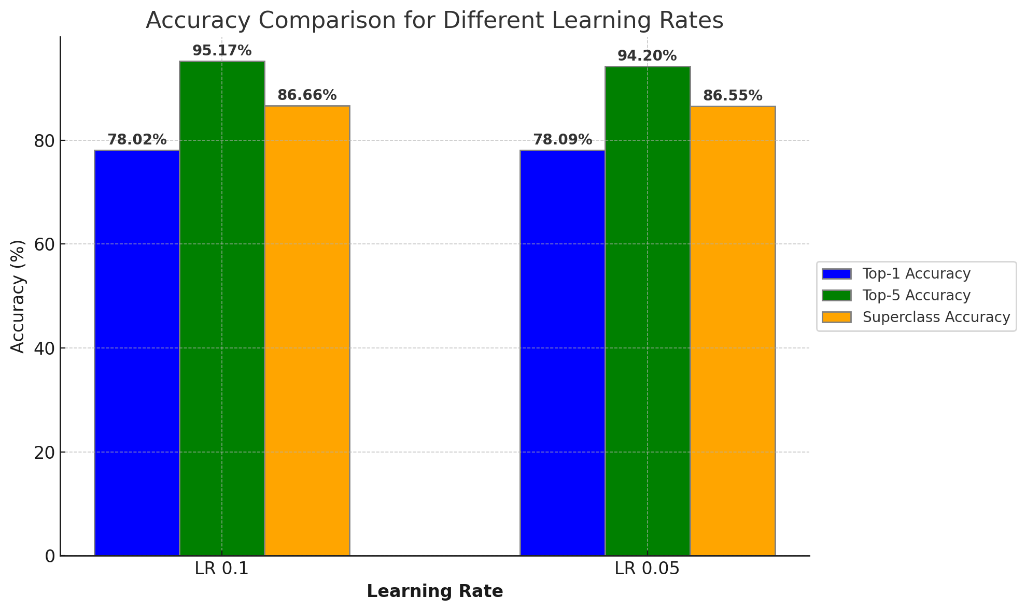
Learning Rate
Applied other conditions uniformly
Dataset: CIFAR-100
Epochs: 100
Model : WideResNet-28-20
Optimizer : SGD with Momentum
Adjustment:
Learning Rate value was adjusted from 0.1 to 0.05 to conduct a performance improvement experiment
Objective:
Performance of the model decreases about 1%
Reducing learning rate from the beginning would be a bad decision for model performance
259.85
258.84

Slide 10
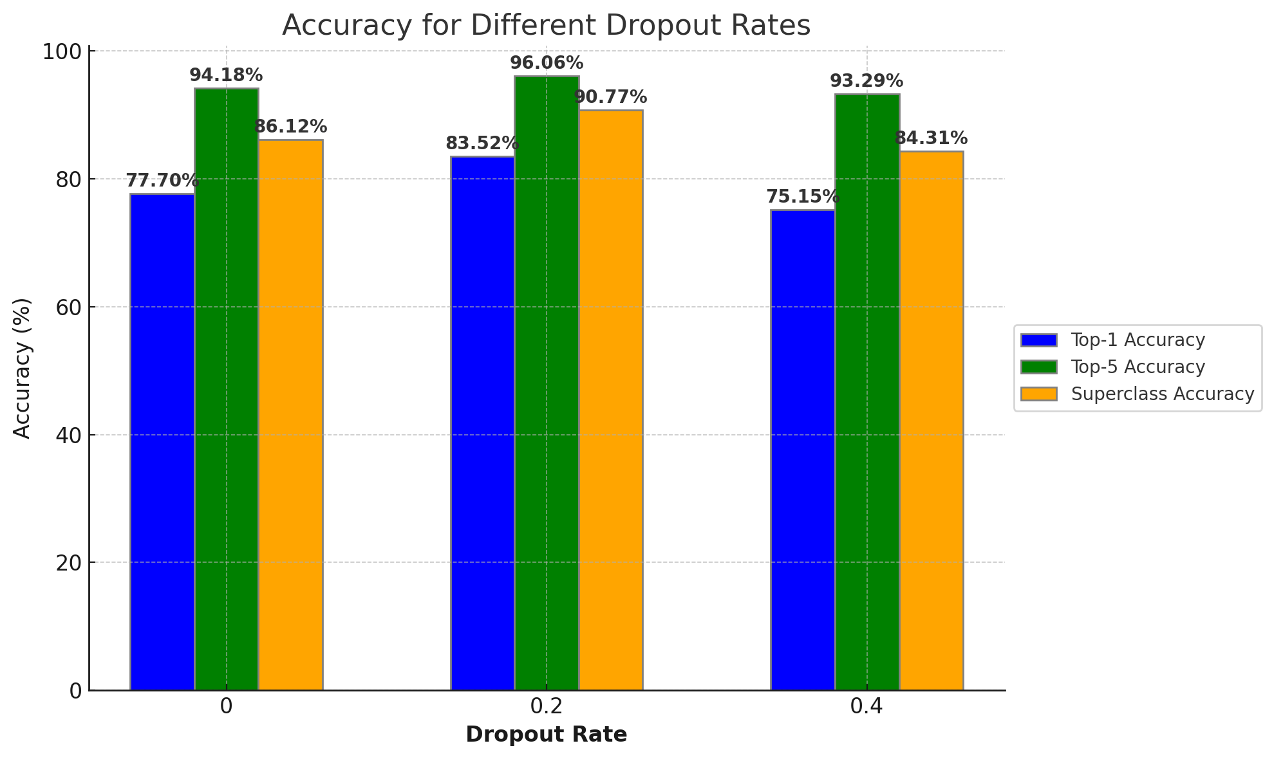
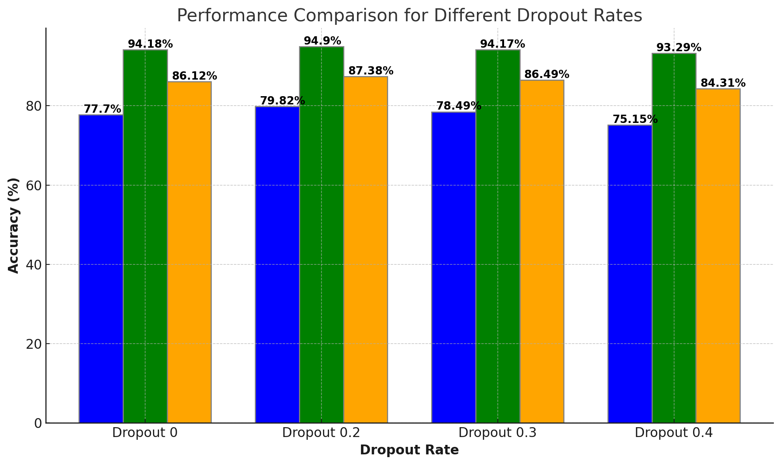
DropOut
Applied other conditions uniformly
Dataset: CIFAR-100
Epochs: 100
Model : WideResNet-28-10
Optimizer : SGD with Momentum
Adjustment:
DropOut value was adjusted between 0 and 0.4 to conduct a performance improvement experiment
Objective:
Setting DropOut value 0.2 was performed well and significantly enhance the accuracy
258
262.1
259.15
252.75

Slide 11
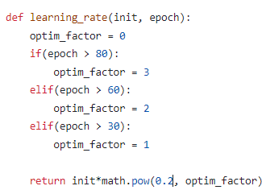
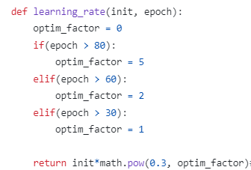
Learning Rate Scheduling
More gradual learning rate decay: Switching from pow(0.2, optin_factor) to pow(0.3, optin_factor) slows down the learning rate reduction, preventing the rapid decrease in training speed during later stages.
Increased training stability: With the slower learning rate decay in the new code, the model can continue making updates in the later stages, preventing premature stopping and improving optimization.

Slide 12
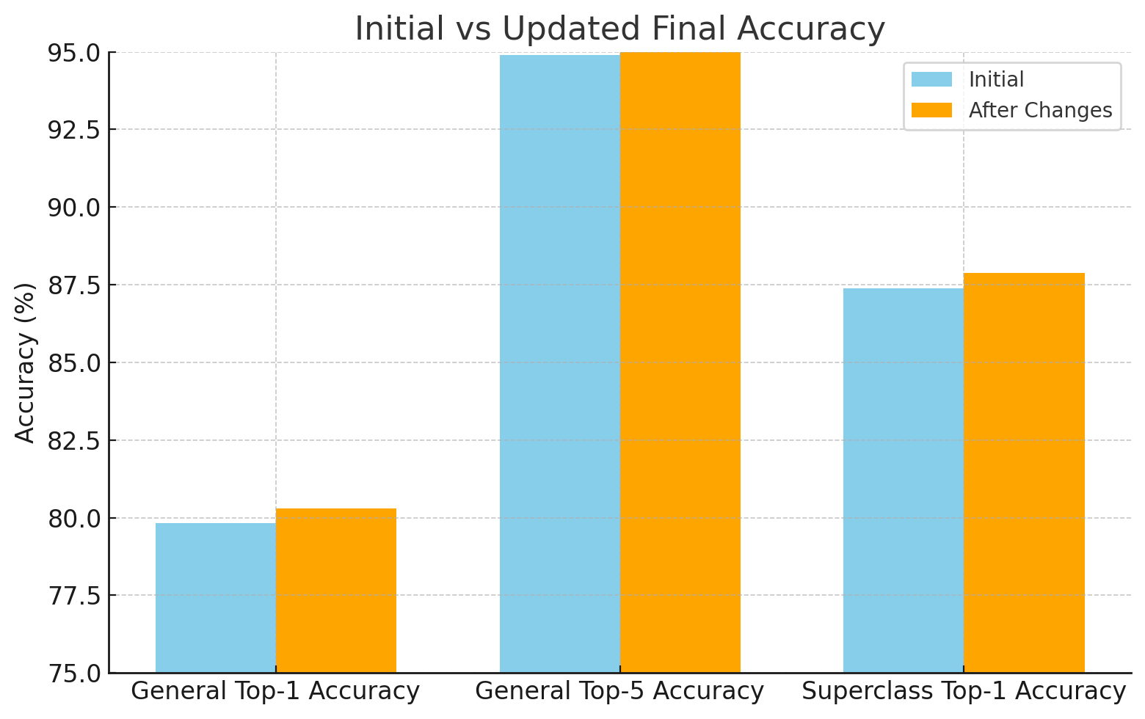
Experiment Results
+1.08
Total : 262.1 -> 263.18
General Top-1 Accuracy: +0.48%
General Top-5 Accuracy: +0.11%
Superclass Top-1 Accuracy: +0.49%

Slide 13
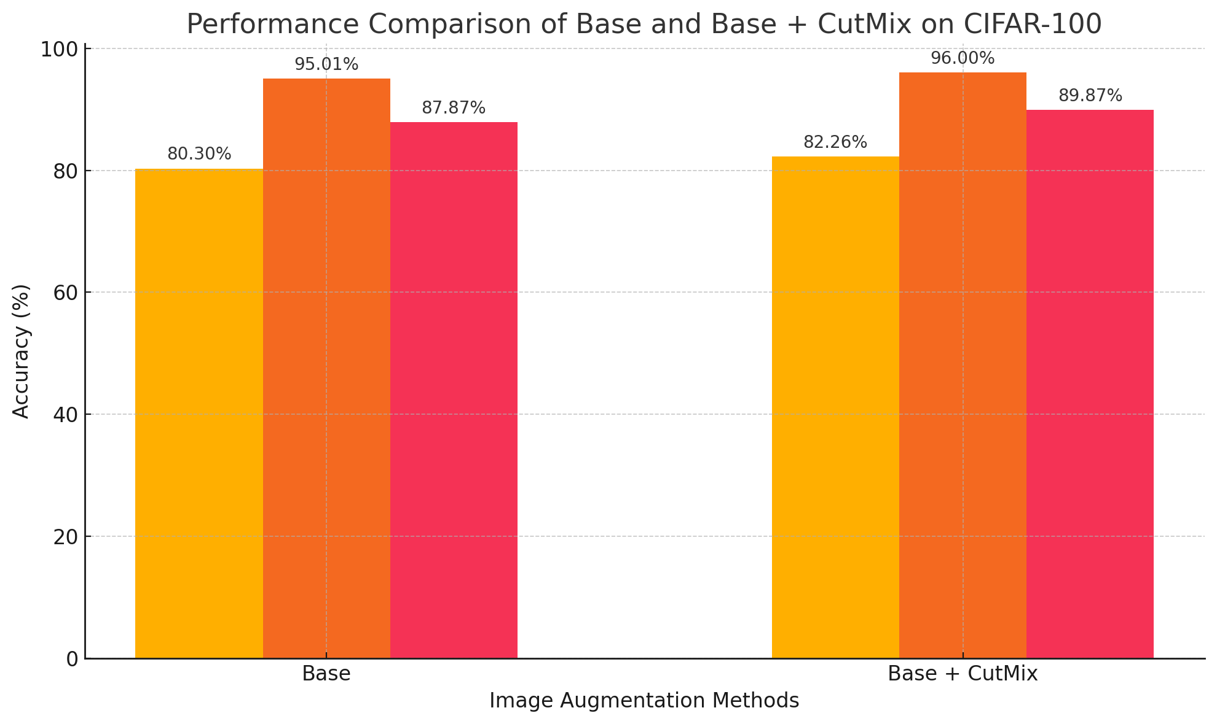
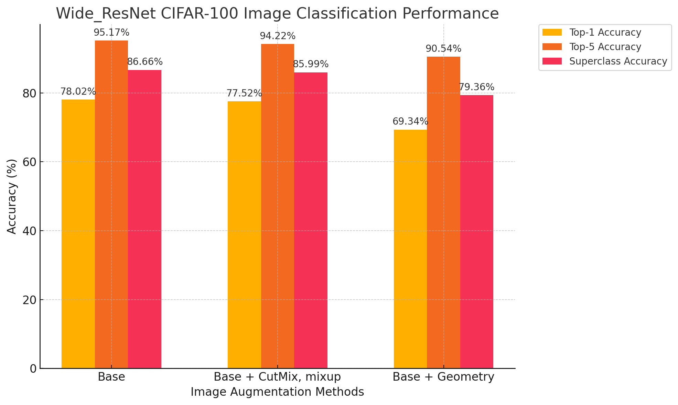
Data Augmentation
Model : WideResNet-28-10
Conditions :
Base Image Augmentation technique : RandomHorizontalFlip(),RandomCrop(32)
Cutmix : Base + Only Cutmix
263.18
268.13
+4.95

Slide 14


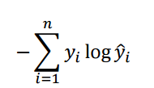

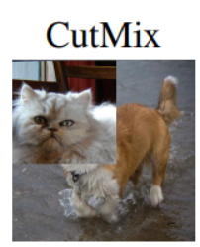
Loss function
CutMix Bounding Box
CutMix Formula
Cross-Entropy Loss Function
Dog : 0.6 Cat : 0.4 lam : 0.6 targets_a : Dog targets_b : Cat
Loss = 0.6*criterion(outputs,dog) + 0.4*criterion(outputs,cat)

Slide 15
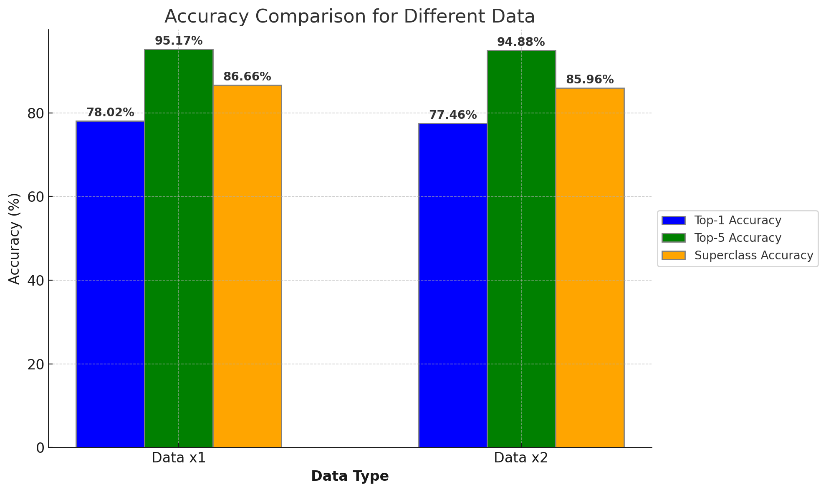
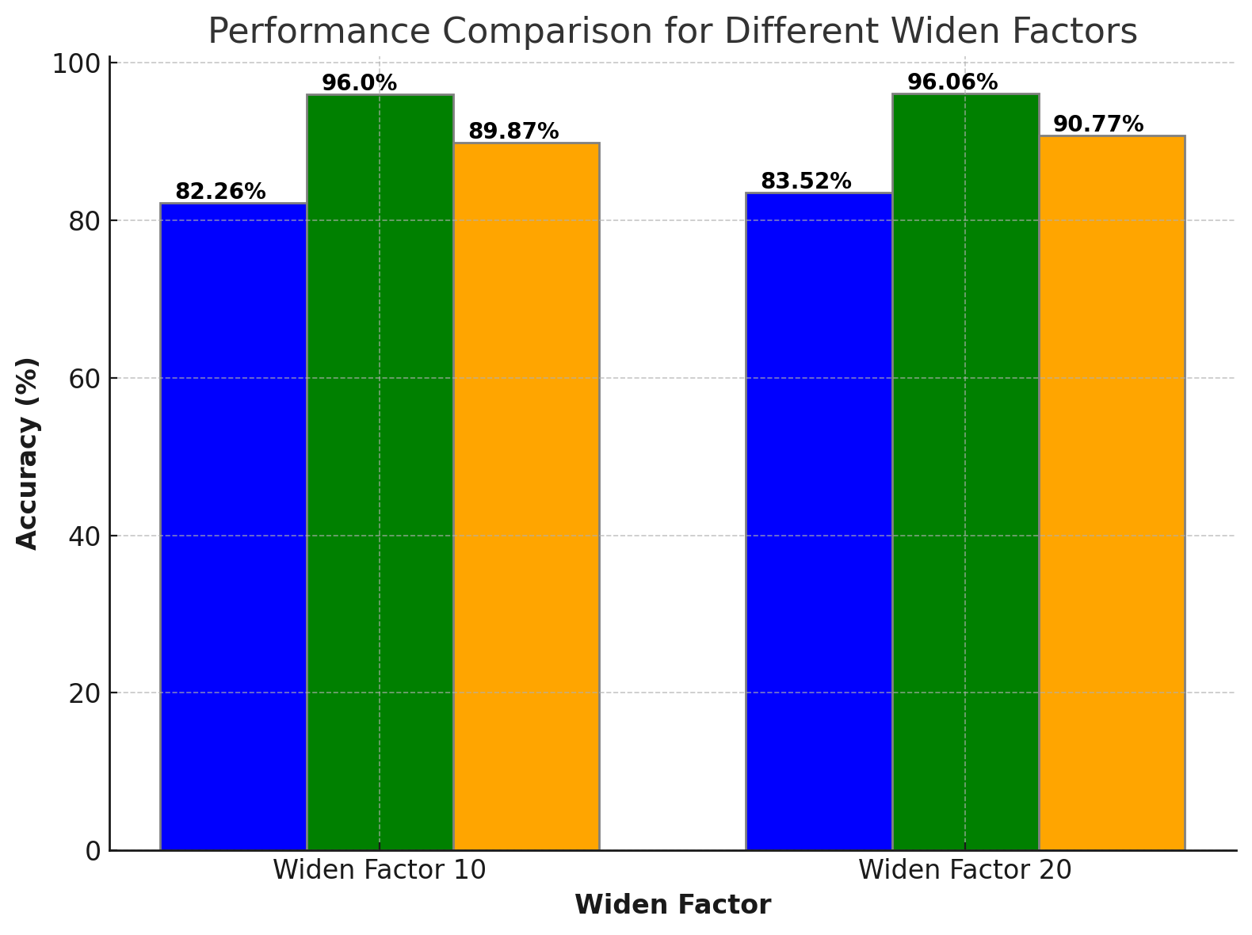
Widen Factor
Applied other conditions uniformly
Dataset: CIFAR-100
Epochs: 100
Optimizer : SGD with Momentum
Adjustment:
Widen factor value was changed to conduct a performance improvement experiment.
10 -> 20
Objective:
Increasing the widen factor leads to an improvement in accuracy, but also results in a proportional increase in training time.
268.13
270.35
+2.22

Slide 16
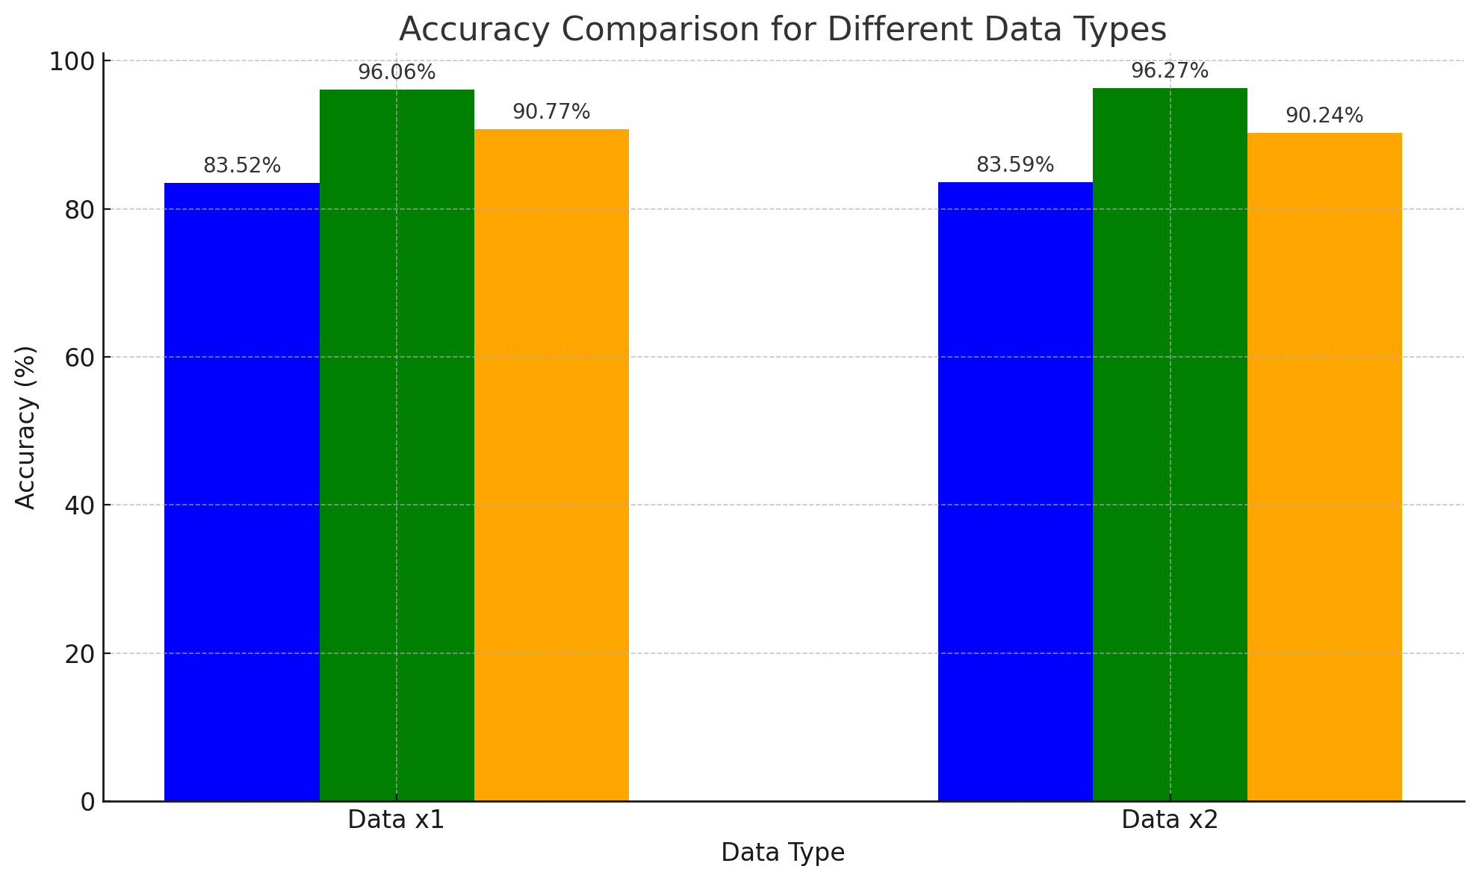
Doubled Data
Applied other conditions uniformly
Dataset: CIFAR-100
Epochs: 100
Model : WideResNet-28-20
Optimizer : SGD with Momentum
Adjustment:
Doubled Training Data to conduct a performance improvement experiment
Original Data
+
Augmentation Data
RandomHorizontalFlip()
RandomCrop()
CutMix()
Objective:
Performance of the model decreases about 1%
270.35
270.1

Slide 17
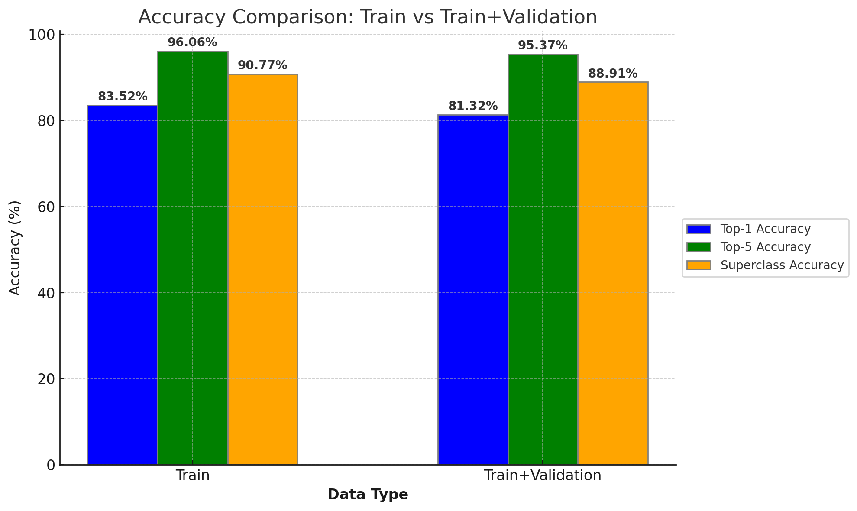
Validation Data
Applied other conditions uniformly
Dataset: CIFAR-100
Epochs: 100
Model : WideResNet-28-20
Optimizer : SGD with Momentum
Adjustment:
Add a validation step
Split 50,000 training images into 40,000 for training and 10,000 for validation
Objective:
Resulted in a drop of about 5 points in the total score
270.35
265.6

Slide 18
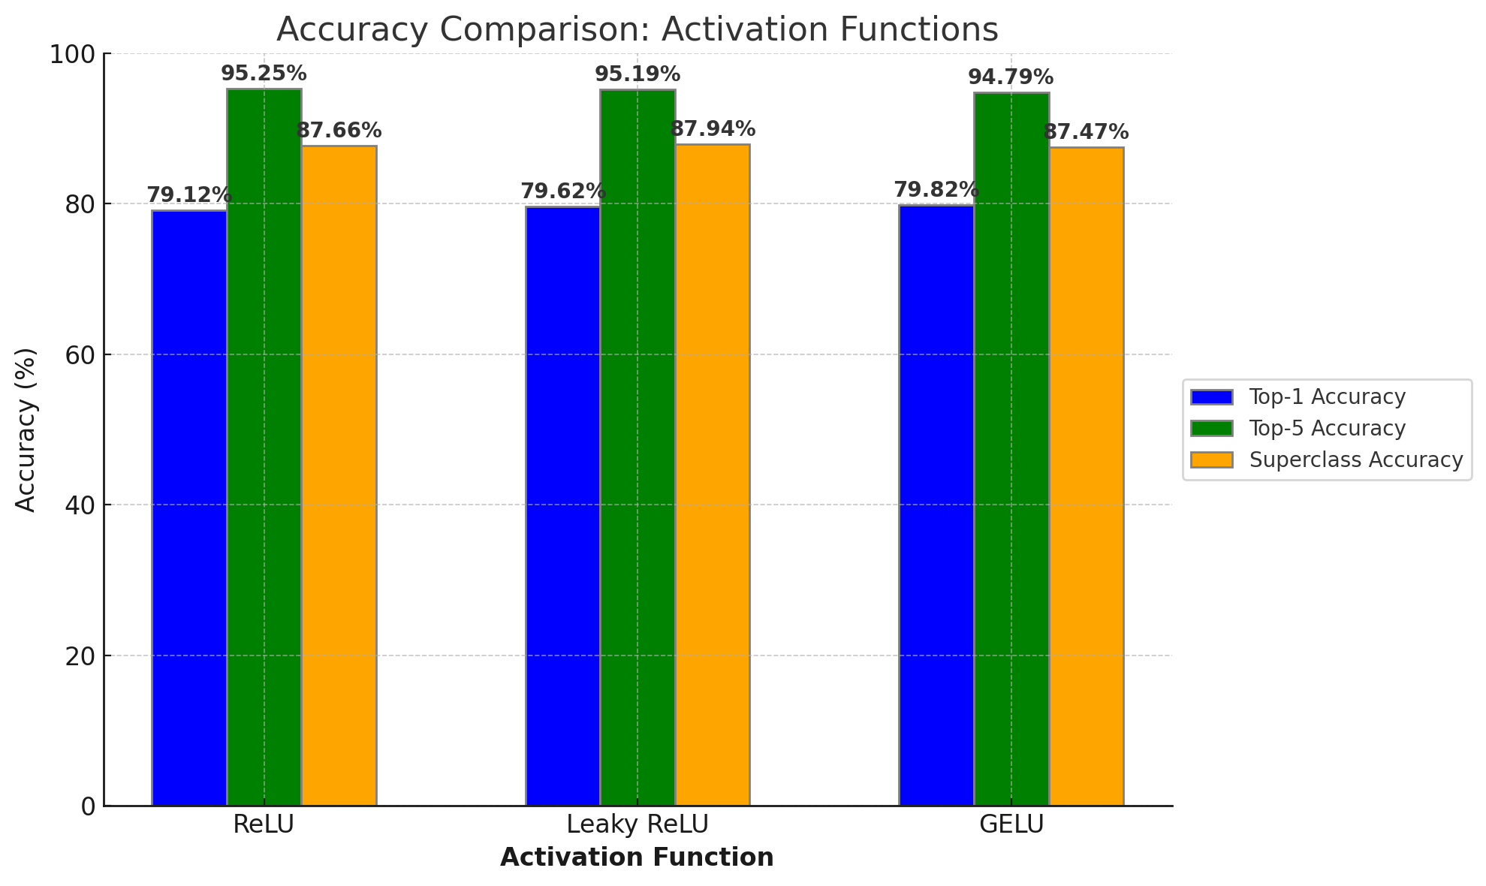
Activation Function
Applied other conditions uniformly
Dataset: CIFAR-100
Epochs: 100
Model : WideResNet-28-4
Optimizer : SGD with Momentum
Adjustment:
Activation Function was changed to conduct a performance improvement experiment.
ReLU
LeakyReLU
GELU
Objective:
Leaky ReLU and GELU improve model performance
Especially Leaky ReLU is would be the best choice for our challenge
262.03
262.75
262.08

Slide 19

Activation Function
Applied other conditions uniformly
Dataset: CIFAR-100
Epochs: 100
Model : WideResNet-28-20
Optimizer : SGD with Momentum
Adjustment:
Activation Function was changed to conduct a performance improvement experiment.
ReLU
LeakyReLU
Objective:
Leaky ReLU improve model performance
270.35
271.48
+1.13

Slide 20
03
Ensemble

Slide 21
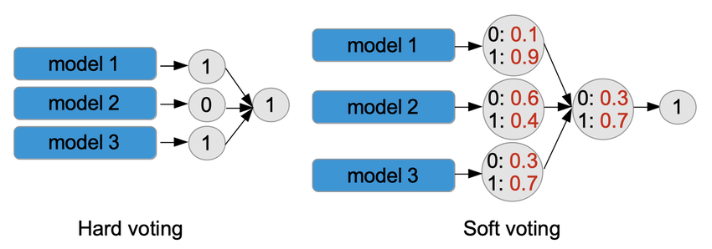
Ensemble
In this case, Class 1 is predicted twice, and Class 0 is predicted once. Therefore, the final prediction will be Class 1, based on the majority rule.

Slide 22
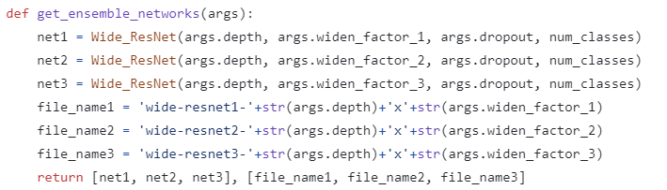
Ensemble_Code
Model_1. Widen_factor 14
Model_2. Widen factor 16
Model_3. Widen factor 16

Slide 23


Ensemble_Code
<Top1 예측>
<Superclass Top1 예측>
The hard voting ensemble is a method that gathers the predictions of each model and selects the final result based on the majority vote.

Slide 24
Ensemble_Code
All predictions in outputs_list are summed, and then divided by the number of models to calculate the average. This average becomes the final prediction score for each class. Next, the top 5 class indices with the highest scores are extracted from outputs_avg.

Slide 25
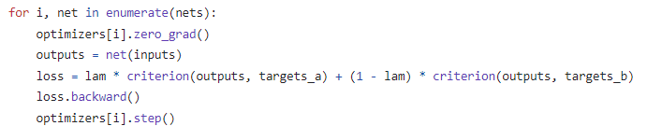
Ensemble_Code
Each of the three models is trained independently.
Each model is trained using a separate optimizer, and the loss is computed and backpropagated to update the parameters. The train function performs training for each model and uses CutMix-augmented data during training.

Slide 26
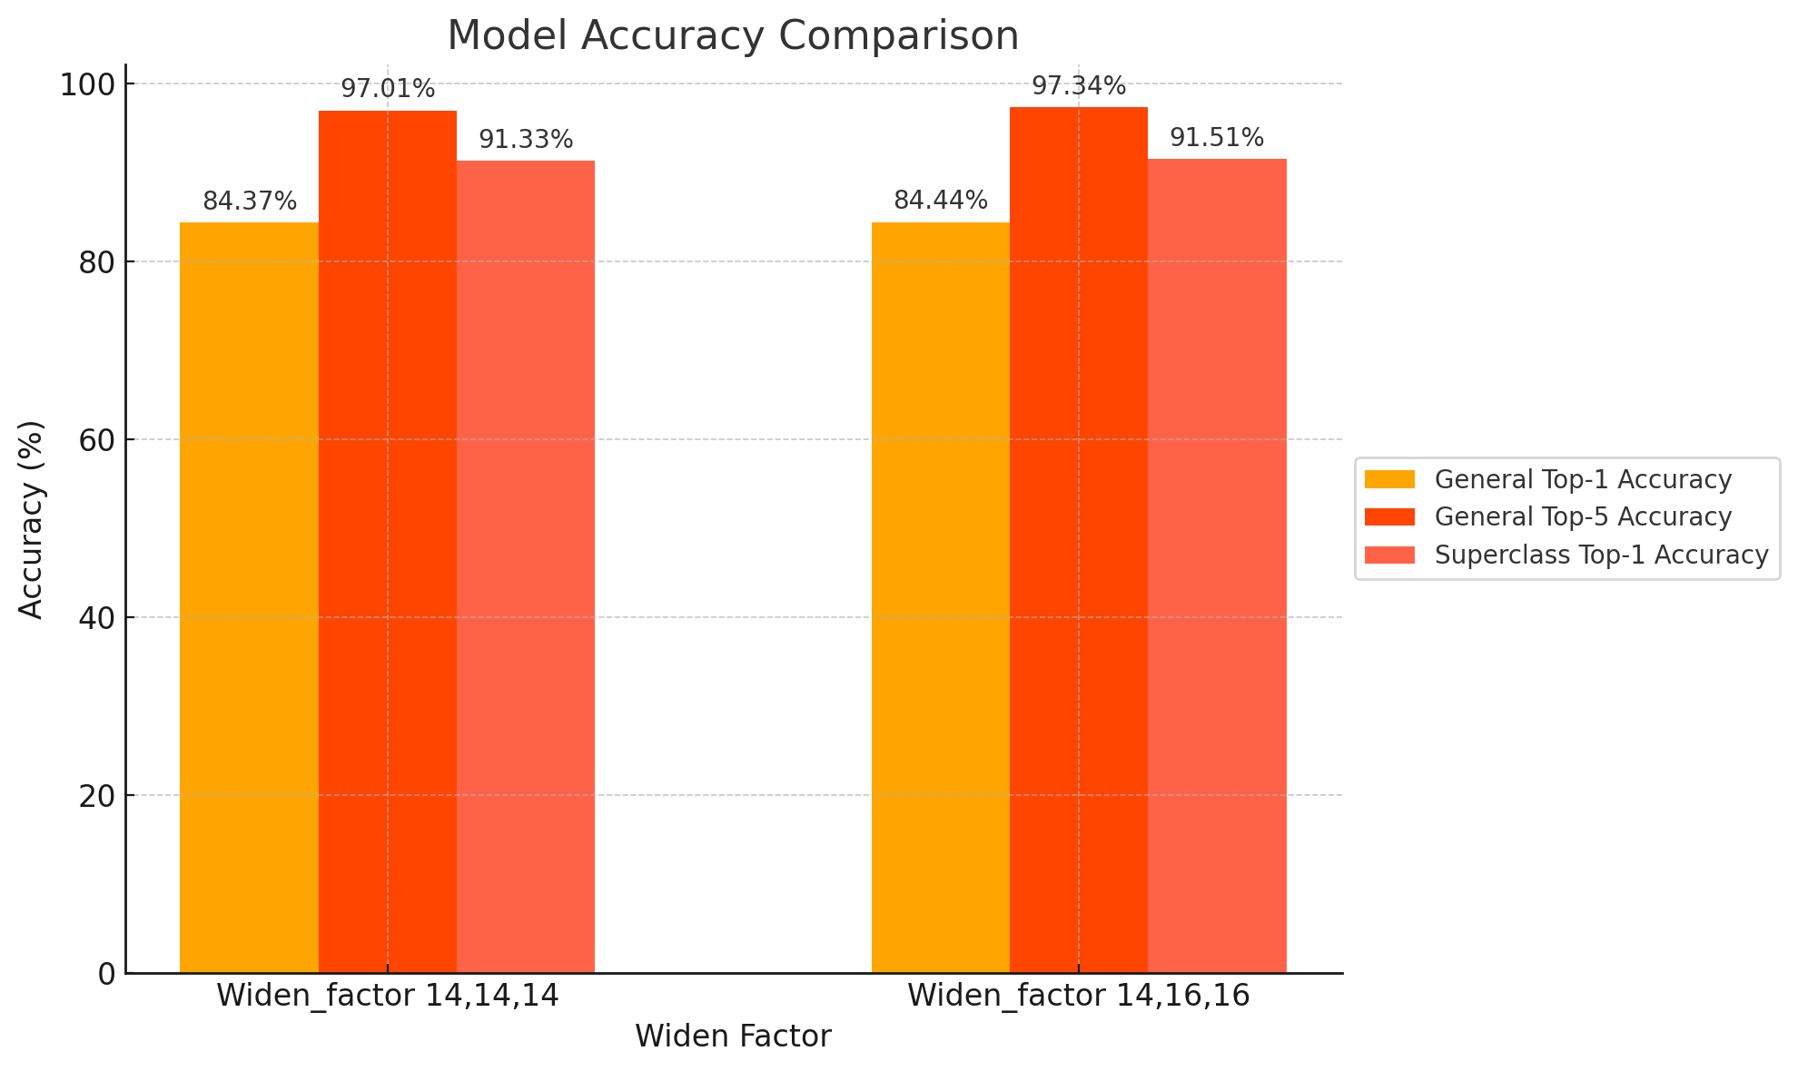
Final best_model
Applied other conditions uniformly
Dataset: CIFAR-100
Epoch: 100
Model : WideResNet-28-14 *3
Model : WideResNet-28-14 , 16, 18
Optimizer : SGD with Momentum
Activation Function LeakyReLU
272.71
273.3
+1.23
+1.81

Slide 27
Thank you

